Slide 1
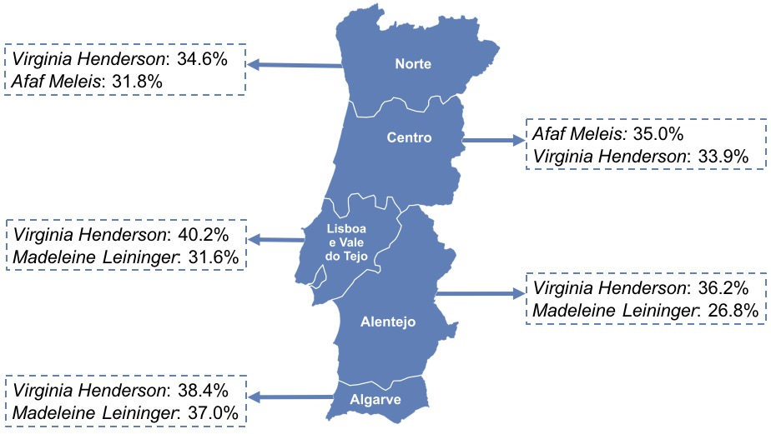
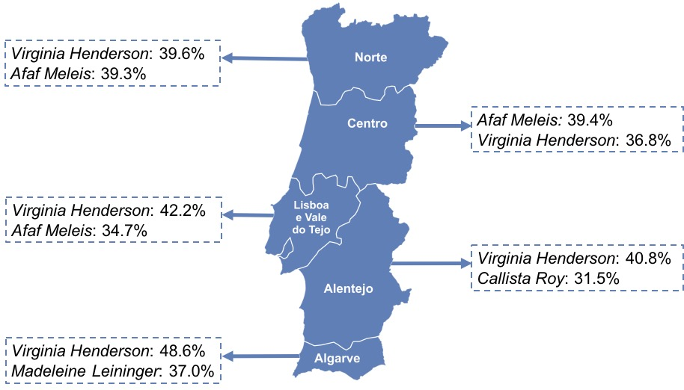
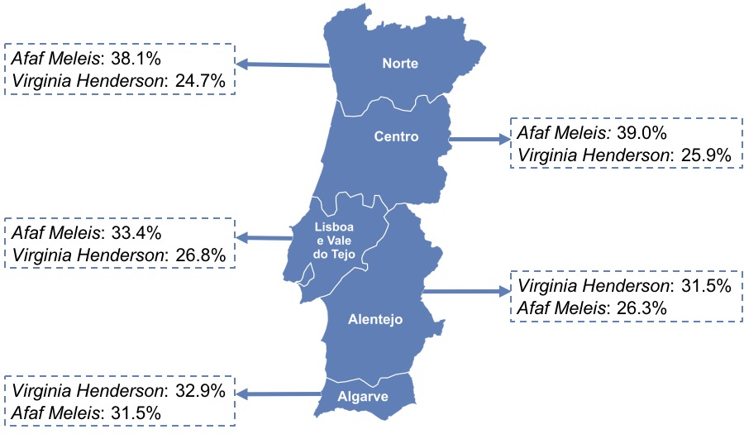

The dying process: contributions to a professional nursing practice grounded in theoretical framework
Autores: Cardoso, Filomena^{I}; Ribeiro, Olga^{I}; Martins, Maria Manuela^{II}
I - Instituto de Ciências Biomédicas Abel Salazar e Centro Hospitalar de São João; II - CINTESIS
Introduction
Methods
More and more in hospital settings, death and the dying process demand from nurses a professional practice that must be consistent with theoretical assumptions. Considering that there is a very relevant theoretical nursing framework to ground the practice, this study was carried out with the aim of analysing the nurses’ assent to the meta-paradigmatic concepts and their application in professional practice, with a special focus on the end-of-life care.
It was designed a quantitative, exploratory and descriptive study which was carried out between July 2015 and March 2016, in 36 hospitals in mainland Portugal. 3451 nurses took part in the field experiment. The tool used for collecting data was the questionnaire. The nurses’ assent to conceptions of nursing, human being, health and environment, in the light of 6 theoretical frameworks on the subject, was evaluated using a Likert scale.
Results
Most of the participants are female (77,1%), between the ages of 25 and 35 years old. Regarding their jobs, 76,3% are nurses, 19,9% are specialist nurses and 3,8% are nurse managers. The conceptions that nurses describe as "fully consistent with their practice" are those of Virginia Henderson, Afaf Meleis, Madeleine Leininger, and Calista Roy.
Enfermagem
Pessoa
Saúde
Ambiente
Discussion
Conclusion
The nurses’ assent to the nursing, human being, health and environment conceptions shows that besides providing basic needs assistance, nurses recognize the relevance of their role in understanding and improving the experiences of people who are coping with the imminence and the inevitability of life’s finiteness^{1,3}.
Given the trends and current challenges, monitoring people in their death processes requires a paradigm shift. In this sense, from a nursing practice that is mainly focused on the satisfaction of needs, a new cultural dominant focus emerges with the aim of improving the experience of people who are facing the death process.
References: ¹Andersson, E., Salickiene, Z., & Rosengren, K. (2016). To be involved – A qualitative study of nurses' experiences of caring for dying patients. Nurse education today, 38, 144-149; ²Rosa, W., Estes, T., & Watson, J. (2017). Caring Science Conscious Dying: An Emerging Metaparadigm. Nursing Science Quarterly, 30(1), 58-64; ³Salimena, A. M., Ferreira, G. C., & Melo, M. C. (2015). Feelings of surgical nursing staff in face of death. Arquivos de Ciências da Saúde, 22(1), 75-78.

