Slide 1

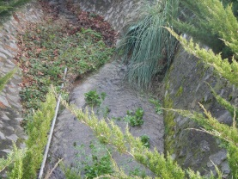
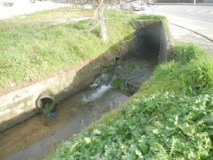
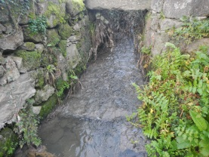
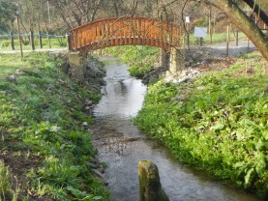
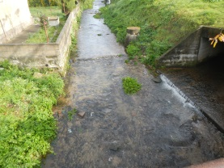
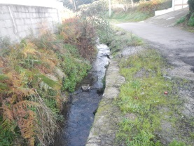
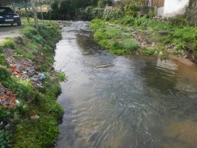
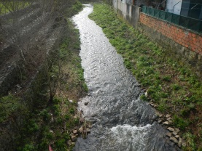
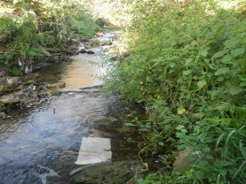
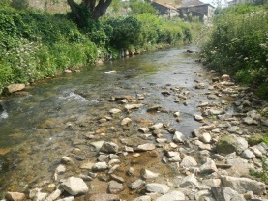
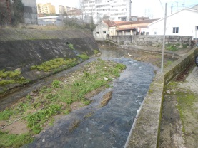
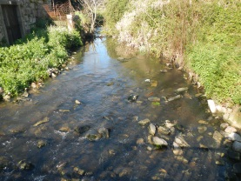
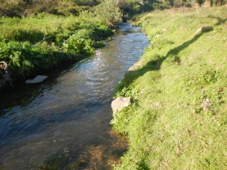
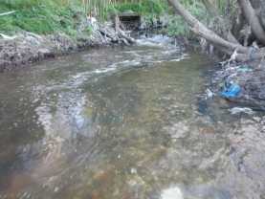
Eco-physiological characterization of the macroinvertebrate communities of a very disturbed urban stream (Tinto river, Portugal):
How they survive?
Álvaro Monteiro, Ana Amado, Isabel Abreu, Maria João Guerreiro, Miguel Costa, Teresa Jesus
  12 de Abril 2017, LIPOR, Portugal

Slide 2
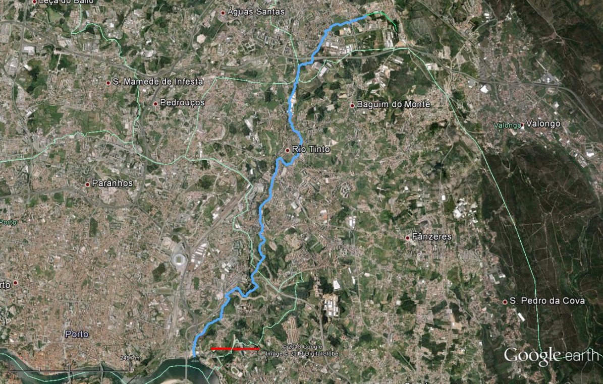
The Project:
Study of some parameters relating to the ecological status
of the Tinto river
is a project proposed by LIPOR, an inter municipal company and developed by the Fernando Pessoa University with the support of:
    the four municipalities which integrates the river basin;
    three water companies;
    and the Portuguese Environmental Agency;
The study is carried out taking account the stablished by the WFD.
Valongo
Maia
Gondomar
Main objectives:
  Characterization of the Tinto river ecological state;
  Detection of the main sources of environmental disturbance;
  Preparation of proposals for measures to improve the ecological status of the river.
Porto
1 Km
Olomouc, Czech Republic SEFS 10 Jul’17

Slide 3
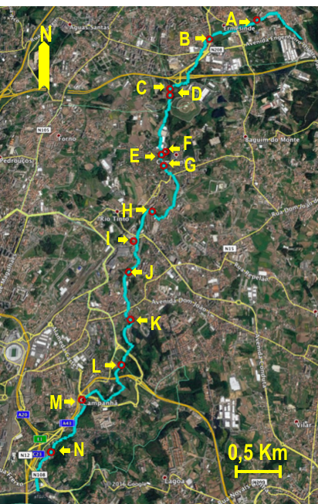
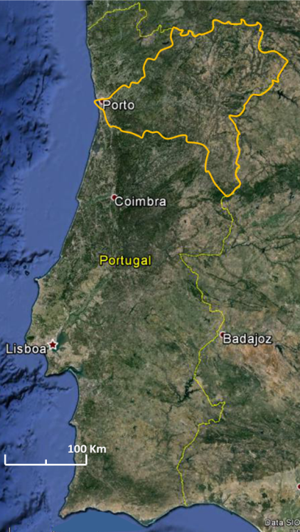
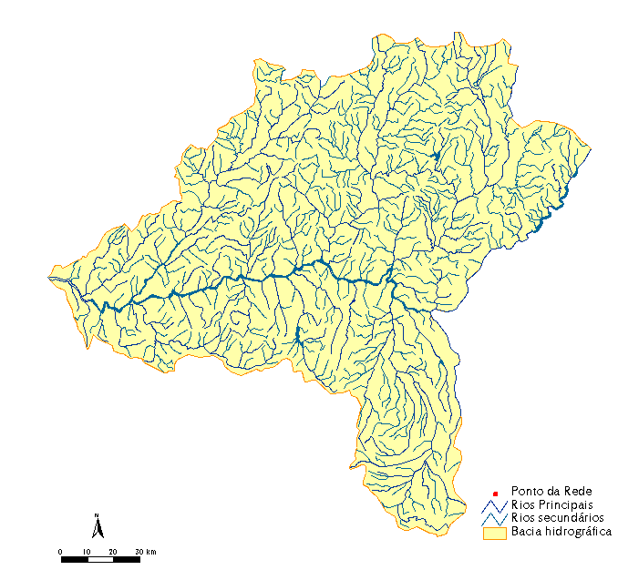
Tinto river
Is a small urban watercourse in the north of Portugal belonging to the Douro river basin with about 11 km long;
Has many sources of environmental disturbance such as: channelization, waste disposal, effluent reception of sewage treatment plants and of untreated urban and industrial effluents.
Olomouc, Czech Republic SEFS 10 Jul’17

Slide 4
Main objectives
Study of some parameters related to the ecological state of Tinto river;
Ecological and physiological characterization of the Tinto river macroinvertebrate communities;
Relate the composition of the macroinvertebrate communities and the environmental conditions.
Olomouc, Czech Republic SEFS 10 Jul’17

Slide 5
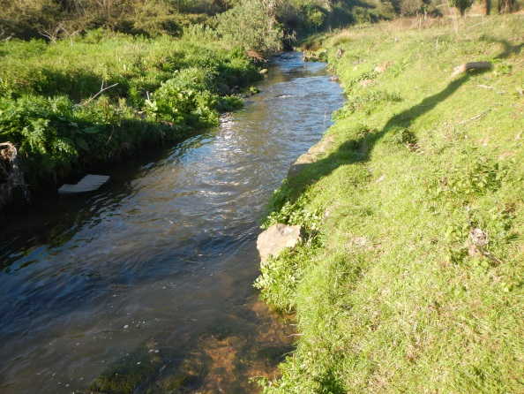


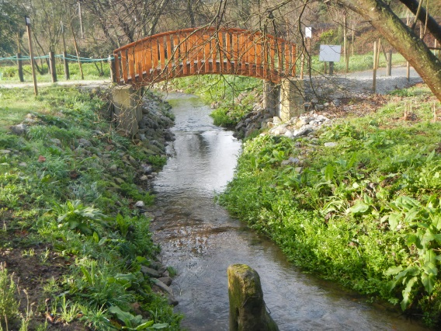







The sampling sites
A
N
N
B
D
E
G
A
H
(1)
J
B
K
D
(3)
(4)
L
(5)
(6)
M
(7)
Granja creek
0,5 Km
(2)
N
0,5 Km
E
G
(8)
H
(9)
J
(10)
(11)
Discharge
K
(12)
L
(13)
Tipology (DQA): Small Northern (N1; <= 100)
Meiral WWTP
Discharge
N
(14)
M
FreixoWWTP
Olomouc, Czech Republic SEFS 10 Jul’17

Slide 6
Parameters
Environmental parameters
Benthic macroinvertebrates
Hydro-morphological parameters (every six months):
substrate composition, habitat quality, macrophytes (%), canopy (%) and flow
Physical and chemical parameters (every months):
  pH, conductivity, % oxygen saturation, BOD₅, NH₄⁺, NO₃⁻ ;NO₂⁻ and P_{total}
Sampling:
  With a hand net
  Every 3 months between december’15 and march’17 (dec’15, mar’16, jun’16, sep’16, dec’16 and mar’17)
Data analysis
Index and metrics:
  Hydromorphological parameters: Habitat quality
  Macroinvertebrate communities:
    Some metrics
    Biotic indexes: RQE and IBMWP
    Shannon´s diversity index and Pielou evenness index
  Spatial variation of all parameters
  N-MDS analysis of macroinvertebrates grouped according a CLUSTER analysis into functional groups and taxa and with the validation of the number of clusters by ANOSIM analysis
  Ordination of the sampling sites made by a PCA attending the values of the environmental parameters
Olomouc, Czech Republic SEFS 10 Jul’17

Slide 7
Hydro morphological parameters
Substrate composition
Macrophytes and canopy
90
90
80
% macrophytes
80
% canopy
70
70
60
Median
60
25%-75%
50
50
Macrophytes (%)
Min-Max
Canopy (%)
40
40
30
30
20
20
10
10
0
0
A
B
D
E
G
H
J
K
L
M
N
Sampling sites
Olomouc, Czech Republic SEFS 10 Jul’17

Slide 8
Flow
2,4
2,2
Median
2,0
1,8
25%-75%
1,6
Min-Max
1,4
1,2
Flow (m³/s)
1,0
0,8
0,6
0,4
0,2
0,0
A
B
D
E
G
H
J
K
L
M
N
Sampling sites
Olomouc, Czech Republic SEFS 10 Jul’17

Slide 9
Habitat quality
 | A | B | D | E | G | H | J | K | L | M | N
Riparian quality (QBR) | 0 | 0 | 30 | 5 | 15 | 15 | 20 | 5 | 30 | 40 | 35
Habitat quality (EPA) | 60 | 92 | 118 | 113 | 130 | 129 | 126 | 109 | 136 | 144 | 120
 | Very Good |  | Good |  | Medium |  | Bad |  | Very bad
Olomouc, Czech Republic SEFS 10 Jul’17

Slide 10
Hydro morphological parameters
2,0
N
1,0
1,5
A
% Canopy
% Macrophytes
1,0
B
0,5
Flow
0,5
QBR
D
Factor 2 : 21,21%
Factor 2: 21,21%
M
0,0
0,0
L
J
K
-0,5
H
-0,5
AVH
-1,0
E
G
-1,5
-1,0
-2,0
-1,0
-0,5
0,0
0,5
1,0
-4
-3
-2
-1
0
1
2
3
4
Factor 1 : 70,19%
Factor 1: 70,19%
Olomouc, Czech Republic SEFS 10 Jul’17

Slide 11
pH and conductivity
10,0
700,0
pH
Condutivity
600,0
8,0
500,0
6,0
400,0
pH
Condutivity (μS/cm)
4,0
300,0
200,0
2,0
Median
25%-75%
100,0
Min-Max
0
A
B
D
E
G
H
J
K
L
M
N
0
Sampling sites
  WFD: pH: between 6 and 9 (The limits can be overcome by natural situations)
Olomouc, Czech Republic SEFS 10 Jul’17

Slide 12
Oxygen saturation and BOD5
Oxygen saturation and BOD₅
90,0
60,0
80,0
50,0
70,0
60,0
40,0
500
% O₂
% O₂
Median
BOD₅ (mg O₂/L)
25%-75%
30,0
400
BOD₅
Min-Max
300
20,0
20,0
10,0
10,0
0
A
B
D
E
G
H
J
K
L
M
N
0
sampling sites
  WFD: BOD₅ <= 6 mg O₂/L;
  %O₂ between 60% and 120%
Olomouc, Czech Republic SEFS 10 Jul’17
Olomouc, Czech Republic SEFS 10 Jul’17

Slide 13
Nitrates, Nitrites and Ammonium
140,0
12,0
NO₃⁻
120,0
NH₄⁺
NO₂⁻
10,0
100,0
Median
8,0
80,0
25%-75%
Nitrates (mg/L)
Min-Max
6,0
Ammonium and Nitrites (mg/L)
60,0
4,0
40,0
20,0
2,0
0
0
A
B
D
E
G
H
J
K
L
M
N
Sampling sites
  WFD: NO₃⁻ <=25 mg NO₃⁻/L;
  NH₄+ <=1 mg NH₄⁺/L
Olomouc, Czech Republic SEFS 10 Jul’17

Slide 14
Total Phosphorous
3,5
Median
3,0
25%-75%
Min-Max
2,5
2,0
P total (mg P/L)
1,5
1,0
0,5
0,0
A
B
D
E
G
H
J
K
L
M
N
Sampling sites
  WFD: Total phosphorpus: <= 0,1mg P/L
Olomouc, Czech Republic SEFS 10 Jul’17

Slide 15
Chemical parameters
3,0
1,0
D
2,5
E
NH₄⁺
2,0
0,5
1,5
1,0
G
Condutivity
L
Factor 2 : 22,33%
Factor 2: 22,33%
0,0
BOD₅
0,5
P _{total}
0,0
N
A
NO²⁻
H
NO₃⁻
pH
-0,5
-0,5
-1,0
M
K
B
J
% O2
-1,5
-1,0
-2,0
-4
-3
-2
-1
0
1
2
3
4
-1,0
-0,5
0,0
0,5
1,0
Factor 1: 63,04%
Factor 1 : 63,04%
Olomouc, Czech Republic SEFS 10 Jul’17

Slide 16
Macroinvertebrates: richness and abundance
11
4000
S
Median
10
n
25%-75%
3500
9
Min-Max
3000
8
2500
7
Number of organisms(n)
Number of taxa(S)
2000
6
1500
5
4
1000
3
500
2
A
B
D
E
G
H
J
K
L
M
N
0
Sampling sites
Olomouc, Czech Republic SEFS 10 Jul’17

Slide 17
Macroinvertebrates: diversity and equitability
1,8
1,0
H'
1,6
E
0,9
1,4
0,8
1,2
0,7
Shannon diversity (H')
Pielou eveness (E)
1,0
0,6
0,8
0,5
0,6
0,4
Median
0,4
25%-75%
0,3
Min-Max
0,2
A
B
D
E
G
H
J
K
L
M
N
0,2
Sampling sites
Olomouc, Czech Republic SEFS 10 Jul’17

Slide 18
Macroinvertebrates: EPT and Diptera taxa
8
EPT
Median
7
Diptera
25%-75%
Min-Max
6
5
Number of families
4
3
2
1
0
A
B
D
E
G
H
J
K
L
M
N
Sampling sites
Olomouc, Czech Republic SEFS 10 Jul’17

Slide 19
Macroinvertebrates: % CHIRONOMIDAE & %Trichoptera
100
% CHIRONOMIDAE
% Trichoptera
Median
25%-75%
80
Min-Max
60
% of organisms
40
20
0
A
B
D
E
G
H
J
K
L
M
N
Sampling sites
Olomouc, Czech Republic SEFS 10 Jul’17

Slide 20
Macroinvertebrates: % clingers,
% reophiles,
%branchial & cutaneous
% clingers
Median
% reophiles
25%-75%
100
% branchial & cutaneous
Min-Max
80
% of organisms
60
40
20
0
A
B
D
E
G
H
J
K
L
M
N
Sampling sites
Olomouc, Czech Republic SEFS 10 Jul’17

Slide 21
Taxa composition
Olomouc, Czech Republic SEFS 10 Jul’17

Slide 22
Taxa composition
A
E
A
A
A
J
A
E
M
M
M
K
D
L
B
N
dec'15
E
M
M
J
N
L
D
N
L
A
H
D
M
E
D
mar'16
G
H
B
L
L
D
K
N
N
E
J
G
K
H
K
L
B
ANOSIM test: R_{global} = 845
H
G
G
J
jun'16
H
J
B
Cluster 2
K
G
N
sep'16
H
B
Cluster 1
dec'16
E
D
mar'17
Mean of each taxa in each cluster
K
G
100
J
B
Cluster 1
Stress: 0,08
80
Cluster 2
 | dec'15 | mar'16 | jun'16 | sep'16 | dec'16 | mar'17
A | 2 | 2 | 2 | 2 | 2 | 2
B | 2 | 1 | 2 | 1 | 1 | 2
D | 2 | 1 | 1 | 2 | 1 | 1
E | 2 | 1 | 2 | 1 | 2 | 2
G | 2 | 2 | 1 | 1 | 2 | 2
H | 2 | 2 | 2 | 2 | 2 | 2
J | 2 | 1 | 2 | 1 | 2 | 2
K | 2 | 1 | 2 | 1 | 2 | 2
L | 1 | 1 | 1 | 2 | 1 | 2
M | 2 | 2 | 2 | 2 | 2 | 2
N | 2 | 1 | 1 | 1 | 1 | 1
60
%
40
20
0
Annelida + Plathelminthes
Crustacea
Odonata
Trichoptera
Mollusca
Ephemeroptera
Coleoptera
Diptera
Taxa
Olomouc, Czech Republic SEFS 10 Jul’17

Slide 23
IBMWP score
Olomouc, Czech Republic SEFS 10 Jul’17

Slide 24
IBMWP scores
N
K
M
J
M
E
E
dec'15
D
L
N
L
D
D
J
M
A
A
B
J
E
N
D
M
mar'16
Cluster 4
D
L
M
H
E
N
N
K
H
G
A
E
Cluster 1
ANOSIM test: R_{global} = 0,823
B
L
L
M
K
G
H
jun'16
K
L
J
H
N
B
G
J
sep'16
G
H
K
G
Cluster 2
dec'16
E
B
B
H
mar'17
Mean of each IBMWP scores in each cluster
G
D
A
100
K
A
A
Cluster 3
J
Cluster 1
B
80
Cluster 2
Stress: 0,12
Cluster 3
 | dec'15 | mar'16 | jun'16 | sep'16 | dec'16 | mar'17
A | 2 | 1 | 1 | 3 | 1 | 2
B | 2 | 4 | 2 | 4 | 3 | 2
D | 1 | 4 | 4 | 1 | 3 | 4
E | 1 | 4 | 1 | 3 | 1 | 1
G | 1 | 2 | 2 | 3 | 2 | 1
H | 1 | 1 | 2 | 1 | 2 | 2
J | 1 | 4 | 2 | 3 | 2 | 1
K | 1 | 4 | 1 | 3 | 2 | 1
L | 4 | 4 | 4 | 1 | 4 | 2
M | 1 | 2 | 1 | 1 | 1 | 1
N | 1 | 4 | 4 | 3 | 4 | 4
Cluster 4
60
%
40
20
0
1
2
3
4
5
6
7
8
IBMWP scores
Olomouc, Czech Republic SEFS 10 Jul’17

Slide 25
Breathing groups
Olomouc, Czech Republic SEFS 10 Jul’17

Slide 26
Breathing groups
N
M
dec'15
A
A
E
J
D
L
L
D
D
A
J
N
M
N
L
mar'16
E
A
H
K
L
N
B
E
M
H
M
M
L
M
E
D
D
N
ANOSIM test: R_{global} = 0,819
G
E
G
B
K
L
K
B
J
jun'16
Cluster 3
A
K
H
J
G
Cluster 4
J
G
H
B
N
sep'16
H
K
G
dec'16
H
B
E
Cluster 2
D
mar'17
Mean of each breathing group in each cluster
100
K
G
Cluster 1
J
Cluster 1
A
B
80
Stress: 0,07
Cluster 2
 | dec'15 | mar'16 | jun'16 | sep'16 | dec'16 | mar'17
A | 3 | 3 | 3 | 1 | 2 | 3
B | 2 | 4 | 2 | 4 | 1 | 2
D | 2 | 4 | 4 | 4 | 1 | 4
E | 3 | 2 | 3 | 1 | 3 | 3
G | 2 | 2 | 2 | 1 | 3 | 3
H | 2 | 3 | 2 | 2 | 2 | 2
J | 2 | 4 | 3 | 1 | 2 | 2
K | 2 | 4 | 2 | 1 | 2 | 2
L | 4 | 4 | 4 | 4 | 4 | 2
M | 4 | 2 | 2 | 2 | 2 | 3
N | 2 | 4 | 4 | 4 | 4 | 4
Cluster 3
60
Cluster 4
%
40
20
0
aerial
aerial & branchial
cutaneous
special
branchial
branchial & cutaneous
pulmonar
Breathing groups
Olomouc, Czech Republic SEFS 10 Jul’17

Slide 27
Feeding groups
Olomouc, Czech Republic SEFS 10 Jul’17

Slide 28
Feeding groups
A
B
N
B
G
J
D
dec'15
Cluster 4
E
N
N
L
mar'16
D
N
K
L
N
K
L
B
Cluster 1
jun'16
ANOSIM test: R_{global} = 0,843
J
M
L
D
D
D
G
L
E
sep'16
B
B
L
H
A
B
M
dec'16
A
H
D
M
N
K
Cluster 3
H
H
K
M
K
J
A
mar'17
Mean of each feeding group in each cluster
J
K
G
J
G
M
H
M
G
H
J
100
A
G
E
M
Cluster 2
E
A
Cluster 1
E
E
80
Cluster 2
Stress: 0,15
Cluster 3
 | dec'15 | mar'16 | jun'16 | sep'16 | dec'16 | mar'17
A | 3 | 2 | 3 | 4 | 2 | 3
B | 3 | 1 | 3 | 1 | 4 | 3
D | 2 | 1 | 1 | 3 | 4 | 1
E | 2 | 1 | 2 | 4 | 2 | 2
G | 2 | 2 | 3 | 4 | 2 | 2
H | 2 | 2 | 3 | 3 | 3 | 2
J | 2 | 1 | 2 | 4 | 2 | 2
K | 2 | 1 | 2 | 4 | 3 | 2
L | 1 | 1 | 1 | 3 | 1 | 3
M | 3 | 2 | 2 | 2 | 2 | 2
N | 2 | 1 | 1 | 1 | 1 | 1
Cluster 4
60
%
40
20
0
Collectors
Predators
Shredders
limnivorous
Scrappers
Feeding groups
Olomouc, Czech Republic SEFS 10 Jul’17

Slide 29
Habitat/locomotion preferences
Olomouc, Czech Republic SEFS 10 Jul’17

Slide 30
Habitat/locomotion
Cluster 2
M
B
N
D
L
dec'15
D
L
L
N
D
D
K
J
A
E
N
D
M
N
M
J
E
mar'16
B
L
E
A
M
E
M
E
ANOSIM test: R_{global} = 0,872
L
N
L
M
K
H
G
jun'16
Cluster 3
J
K
L
K
H
A
H
G
G
sep'16
N
B
J
G
H
G
J
dec'16
E
H
K
D
B
mar'17
A
B
H
Cluster 4
Mean of each habitat/locomotion group in each cluster
G
K
100
Cluster 1
J
A
Cluster 1
B
A
80
Cluster 2
Stress: 0,1
Cluster 3
 | dec'15 | mar'16 | jun'16 | sep'16 | dec'16 | mar'17
A | 1 | 2 | 2 | 1 | 2 | 1
B | 1 | 3 | 4 | 3 | 1 | 4
D | 2 | 3 | 3 | 3 | 1 | 3
E | 2 | 2 | 2 | 1 | 2 | 2
G | 2 | 2 | 4 | 1 | 2 | 2
H | 2 | 2 | 4 | 2 | 4 | 2
J | 2 | 3 | 4 | 4 | 2 | 2
K | 2 | 3 | 2 | 4 | 4 | 2
L | 3 | 3 | 3 | 3 | 3 | 2
M | 3 | 2 | 2 | 2 | 2 | 2
N | 2 | 3 | 3 | 3 | 3 | 3
Cluster 4
60
%
40
20
0
clingers
divers
sprawlers
burrowers
swimmers
climbers
Habitat/locomotion
Olomouc, Czech Republic SEFS 10 Jul’17

Slide 31
Flow preferences
Olomouc, Czech Republic SEFS 10 Jul’17

Slide 32
Flow preferences
D
M
B
D
H
K
J
A
dec'15
N
D
N
N
L
K
G
B
G
E
J
L
N
B
B
H
mar'16
B
L
A
N
D
L
L
A
H
Cluster 3
ANOSIM test: R_{global} = 0,832
Cluster 4
D
L
B
jun'16
D
J
K
E
M
H
sep'16
A
D
J
G
G
dec'16
A
M
M
J
K
H
G
K
Cluster 1
N
A
G
mar'17
Mean of each flow preference in each cluster
K
M
E
H
J
M
E
100
Cluster 2
Cluster 1
E
E
Cluster 2
Stress: 0,04
80
Cluster 3
 | dec'15 | mar'16 | jun'16 | sep'16 | dec'16 | mar'17
A | 3 | 2 | 4 | 1 | 2 | 3
B | 3 | 1 | 3 | 4 | 4 | 3
D | 2 | 4 | 1 | 4 | 4 | 1
E | 2 | 2 | 2 | 4 | 2 | 2
G | 2 | 3 | 3 | 4 | 3 | 2
H | 2 | 2 | 3 | 1 | 3 | 3
J | 2 | 4 | 3 | 1 | 3 | 2
K | 2 | 1 | 2 | 1 | 3 | 2
L | 4 | 1 | 1 | 1 | 4 | 3
M | 4 | 2 | 2 | 2 | 2 | 2
N | 2 | 1 | 4 | 4 | 4 | 1
Cluster 4
60
%
40
20
0
limnophiles
reophiles
most limnophiles
most reophiles
Flow preferences
Olomouc, Czech Republic SEFS 10 Jul’17

Slide 33
Biological quality
 |  | A | B | D | E | G | H | J | K | L | M | N
IBMWP | dec'15 | 17 | 36 | 15 | 12 | 18 | 29 | 19 | 20 | 11 | 7 | 12
 | mar'16 | 20 | 7 | 7 | 12 | 12 | 24 | 12 | 19 | 12 | 16 | 21
 | jun'16 | 17 | 16 | 15 | 20 | 19 | 33 | 18 | 19 | 16 | 15 | 12
 | sep'16 | 9 | 20 | 18 | 10 | 11 | 32 | 32 | 17 | 12 | 21 | 11
 | dec'16 | 20 | 28 | 6 | 14 | 15 | 15 | 30 | 30 | 23 | 12 | 7
 | mar'17 | 39 | 36 | 12 | 18 | 18 | 21 | 15 | 25 | 19 | 12 | 12
 |  | A | B | D | E | G | H | J | K | L | M | N
RQE | dec'15 | 0,20 | 0,33 | 0,20 | 0,19 | 0,21 | 0,27 | 0,19 | 0,22 | 0,19 | 0,14 | 0,21
 | mar'16 | 0,31 | 0,17 | 0,12 | 0,23 | 0,23 | 0,24 | 0,19 | 0,22 | 0,22 | 0,24 | 0,23
 | jun'16 | 0,19 | 0,23 | 0,21 | 0,20 | 0,33 | 0,28 | 0,23 | 0,35 | 0,23 | 0,21 | 0,18
 | sep'16 | 0,22 | 0,25 | 0,17 | 0,18 | 0,14 | 0,28 | 0,26 | 0,22 | 0,23 | 0,24 | 0,20
 | dec'16 | 0,30 | 0,26 | 0,16 | 0,12 | 0,22 | 0,22 | 0,30 | 0,29 | 0,21 | 0,21 | 0,09
 | mar'17 | 0,40 | 0,35 | 0,20 | 0,19 | 0,22 | 0,22 | 0,21 | 0,25 | 0,25 | 0,20 | 0,20
 | Very Good |  | Good |  | Medium |  | Bad |  | Very bad
Olomouc, Czech Republic SEFS 10 Jul’17

Slide 34
Conclusions
After analyzing the data collected it turns out that the ecological status of the Tinto river varies between insufficient and bad
This classification is due to:
  Problems on the water quality level as seems to indicate the analysis of physical-chemical parameters and benthic macroinvertebrate communities;
  Sectors of the Tinto river in which the hydro-morphological characteristics "natural" are quite changed;
  Existence of areas along the watercourse where placement and structure of the banks also lead to this type of classification.
Olomouc, Czech Republic SEFS 10 Jul’17

Slide 35
Conclusions
The communities of macroinvertebrates present along the Tinto river are:
  Poor of the taxonomic point of view;
  Presenting relatively low values of diversity;
  Are dominated by organisms belonging to Annelida and Diptera with some presence of other faunal groups such as Ephemeroptera and Mollusca.
From a functional point of view the communities are constituted by:
  Organisms dependent of dissolved oxygen in the water to breathe but where there are also great amount of individuals with adaptations that allow them to survive in anoxic environment,;
  Collectors shredders and limnivorous organisms;
  Macroinvertebrates that prefer living buried in the substrate or in the water column (swimmer organisms).
Despite the lack of diversity of organisms found is achieved through the analysis of benthic macroinvertebrate community differentiate the various sampling sites according to their different levels of environmental disturbance.
Olomouc, Czech Republic SEFS 10 Jul’17

Slide 36
Conclusions
 | A | B | D | E | G | H | J | K | L | M | N
Conductivity (μS/cm) | 39,5-251 |  | 58,8-440 |  | 43,1-380 |  |  |  | 46,8-596
Maximum BOD₅ (mg O₂/L) | 28,7 |  | 34,9 |  | 35,1 |  |  |  | 50,7
Maximum NH₄⁺ (mg/L) | 0,36 |  | 13,07 |  | 5,85 |  |  |  | 7,38
Maximum NO₃ ⁻ (mg/L) | 25,2 |  | 40 |  | 42,1 |  |  |  | 129,9
Maximum number of taxa | 10 |  | 7 |  | 10 |  |  |  | 7
Taxa composition | Diptera>Annelida>Ephemeroptera>Mollusca |  | Diptera/annelida>Ephemeroptetra |  | Diptera>Annelida>Ephemeroptetra |  |  |  | Annelida/Diptera>Ephemeroptetra
Breathing groups | Branchial &cutaneous>special>pulmonar |  | Special>Branchial& Cutaneous>Branchial |  | Branchial &cutaneous>special><branchial |  |  |  | Special>Branchial & Cutaneous
Feeding groups | Predators>Shredders>Collectors |  | Shredders>Limnivorous>collectors |  | Shredders>Collectors>Limnirous |  |  |  | Limnivrous>Collectors>Shredders
Habitat preferences | Climbers>Burrowers>Clingers>Swimmers |  | Burrowers>Climbers |  | Climbers>Burrowers>Clingers |  |  |  | Burrowers>Climbers>Clingers
Flow preference | Most limnopfiles>Reophiles |  | Most limnophiles> most reophiles>reophiles |  | Reophiles>Most reophiles>Most limnophiles |  |  |  | Most limnophiles>Most reophiles> Reophiles
Olomouc, Czech Republic SEFS 10 Jul’17

Slide 37
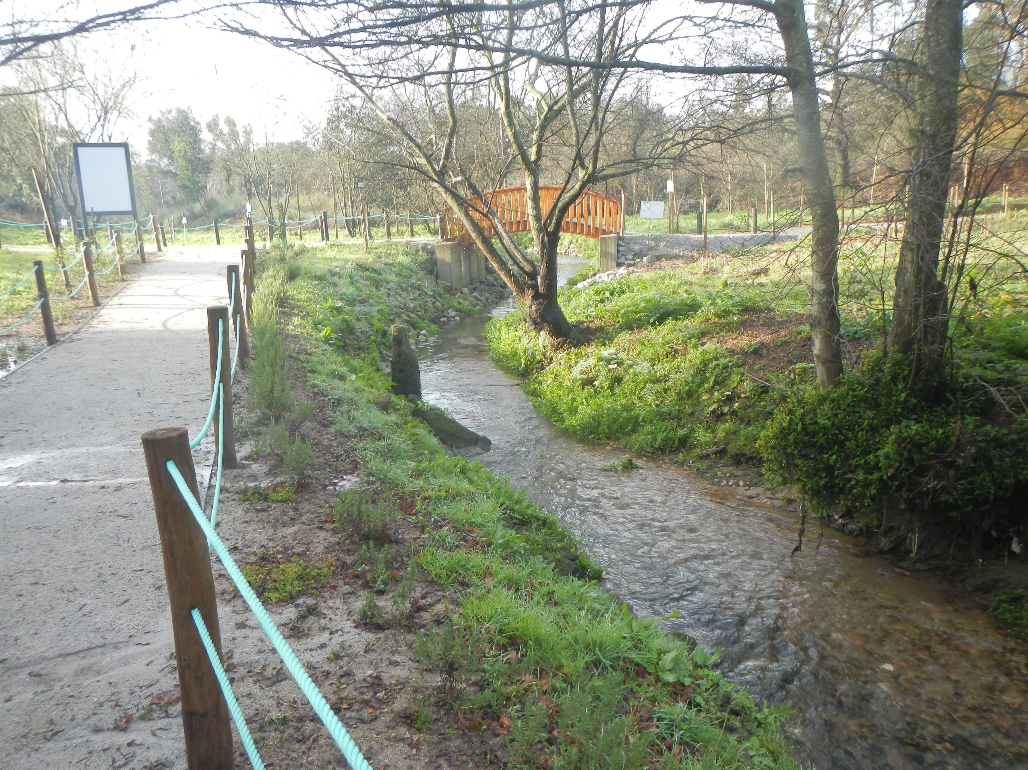
Thank you!!!

